Slide 1
Application Delivery Fundamentals 2.0 B:
Prometheus and Grafana

Slide 2
Goals
Observability Concepts
Prometheus fundamentals
PromQL
Instrumentation and Exporters
Alerting & Dashboarding
Alerting advanced
Alert Manager HA
Prometheus Federation
Grafana

Slide 3
Observability
Observability is the measure of how well the internal states of a system can be inferred from knowledge of its external outputs.
Often confused with monitoring, observability goes a step further by identifying issues in a system and why those issues occur.
It’s from control theory and has become super crucial in software engineering, especially with the rise of complex, distributed systems and microservices.
Observability collects data from metrics, logs, and traces, the three pillars, to give a complete view of a system’s health and performance.

Slide 4
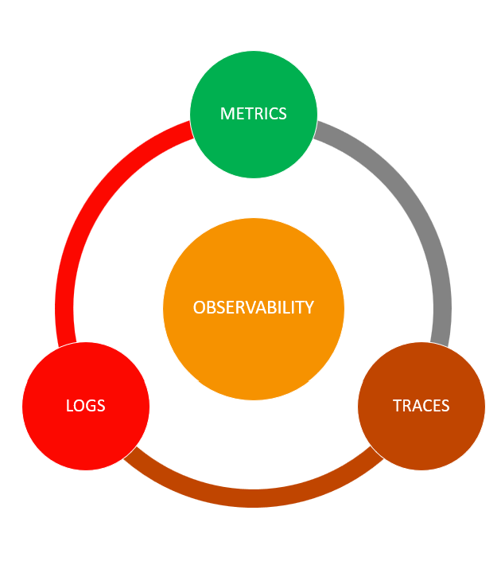
Observability

Slide 5
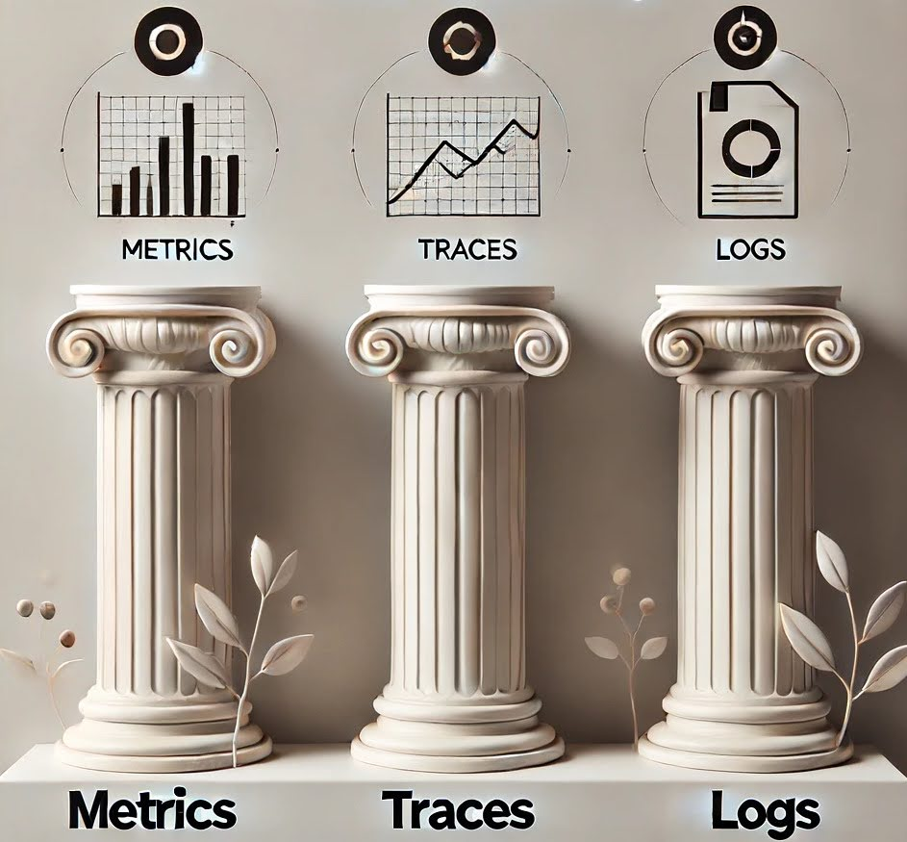
Observability

Slide 6
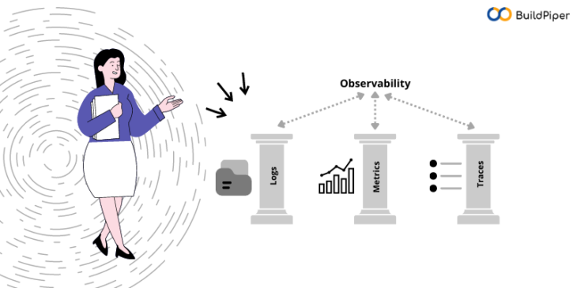
Observability

Slide 7
Need for Comprehensive Observability
Less downtime: Faster detection and fixing means reduced downtime and more customer service.
Better decisions: With visibility into system performance, management can make better decisions on resource allocation and strategic improvements.
Develop and run faster: Developers and ops teams can catch bottlenecks or failures before they become big problems.
Better customer experience: Smoother system operation means less customer friction and better service overall.

Slide 8
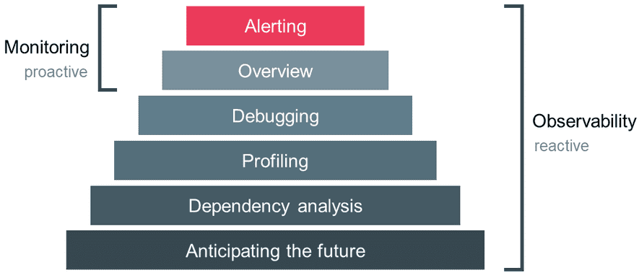
Observability vs Monitoring

Slide 9
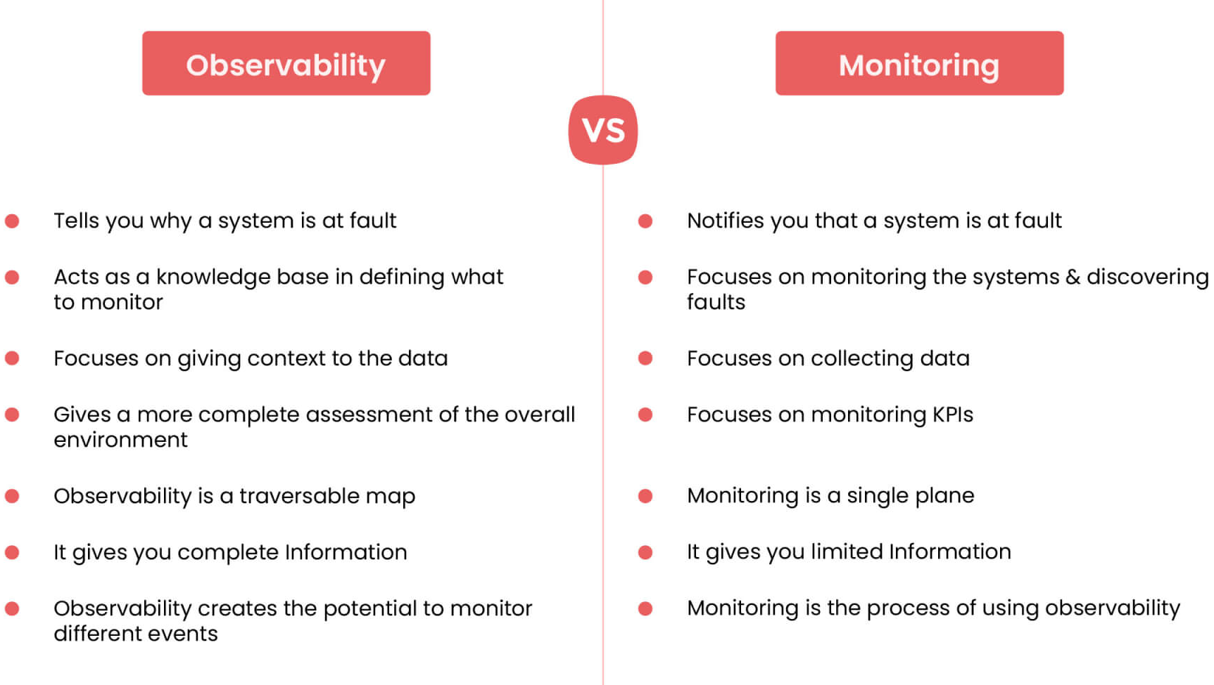
Observability vs Monitoring

Slide 10
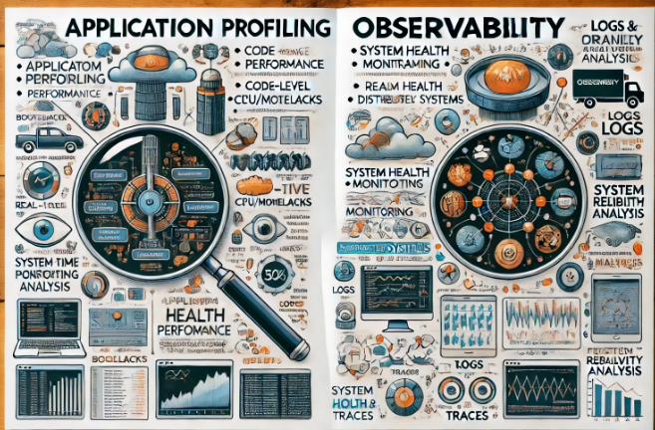
Profiling

Slide 11
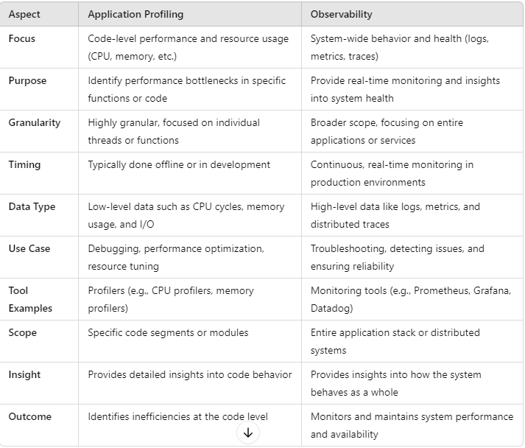
Profiling

Slide 12
Metrics
Metrics" refers to quantifiable measurements used to track and assess the performance or progress of a specific process, activity, or objective.
Metrics are essential in various fields, including business, technology, healthcare, and education, to provide objective data for decision-making, analysis, and improvement.
There are many types of metrics, depending on the context.

Slide 13
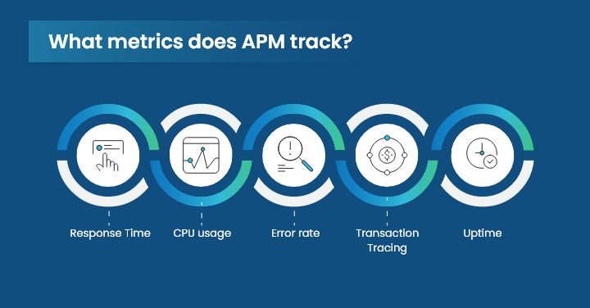
Metrics

Slide 14
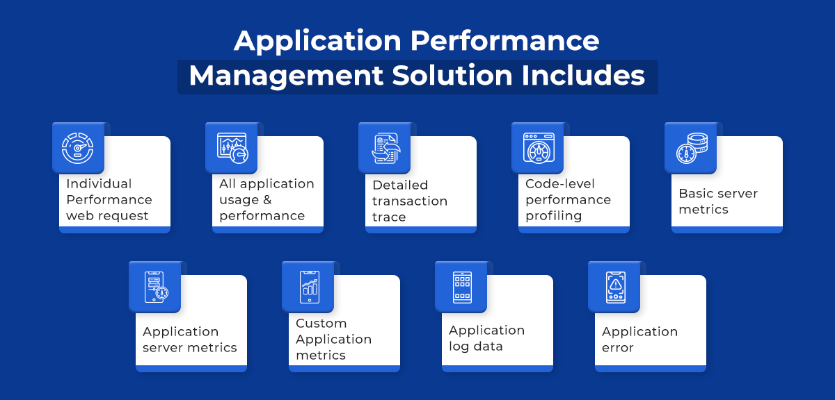
Metrics

Slide 15
Types of Metrics
Business Metrics:
Revenue Growth: Measures the increase in revenue over a certain period.
Profit Margin: Percentage of profit generated from total revenue.
Customer Acquisition Cost (CAC): The cost of acquiring a new customer.
Net Promoter Score (NPS): Measures customer satisfaction and likelihood to recommend a service/product.
Churn Rate: The percentage of customers who stop using a service/product.

Slide 16
Types of Metrics
Financial Metrics:
Return on Investment (ROI): Measures profitability relative to the investment cost.
Gross Profit Margin: A company's total sales revenue minus its cost of goods sold (COGS).
Debt-to-Equity Ratio: A measure of a company's financial leverage.

Slide 17
Types of Metrics
Project Management Metrics:
On-time Delivery: The percentage of projects delivered by the scheduled due date.
Budget Variance: The difference between the budgeted cost and the actual cost.
Scope Changes: Number or percentage of changes made to the project scope.

Slide 18
Types of Metrics
Technology/Software Development Metrics:
Velocity: Measures the amount of work completed during a sprint (agile metric).
Mean Time to Repair (MTTR): Average time to fix a system after a failure.
Defect Density: The number of defects found in each amount of code.

Slide 19
Types of Metrics
Healthcare Metrics:
Patient Satisfaction Score: Measures patient satisfaction with healthcare services.
Average Length of Stay (ALOS): The average number of days a patient spends in the hospital.
Readmission Rates: The percentage of patients who return to the hospital after discharge.

Slide 20
Types of Metrics
Marketing Metrics:
Conversion Rate: The percentage of visitors who take a desired action (e.g., purchasing).
Click-through Rate (CTR): The percentage of people who clicked on a link after seeing an ad or email.
Cost Per Lead (CPL): The average cost of acquiring a lead.

Slide 21
Types of Metrics
Human Resources Metrics:
Employee Turnover Rate: The percentage of employees who leave a company over a given period.
Absenteeism Rate: Measures employee absences as a percentage of the workforce.
Employee Engagement Score: A measure of employees' emotional investment in their work.

Slide 22
Importance of Metrics
Performance Measurement:
Metrics allow organizations to gauge how well they are meeting objectives or standards.
Decision-Making: With data from metrics, businesses can make informed decisions regarding strategy, resource allocation, and priorities.
Benchmarking: Metrics help compare performance over time or against competitors.
Continuous Improvement: Metrics enable tracking of progress and identification of areas needing improvement.

Slide 23
Understand logs and events
Logs and events are essential components in monitoring and analyzing systems, networks, and applications.
They provide critical insights into the performance, security, and operational status of infrastructure, helping in troubleshooting, auditing, and improving overall system health.
Understanding the distinction between logs and events and how they are used can help us better interpret system behaviors.

Slide 24
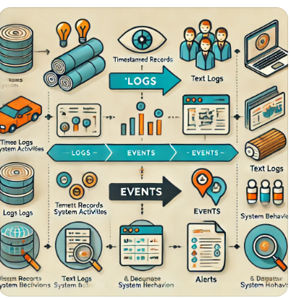
Understand logs and events

Slide 25
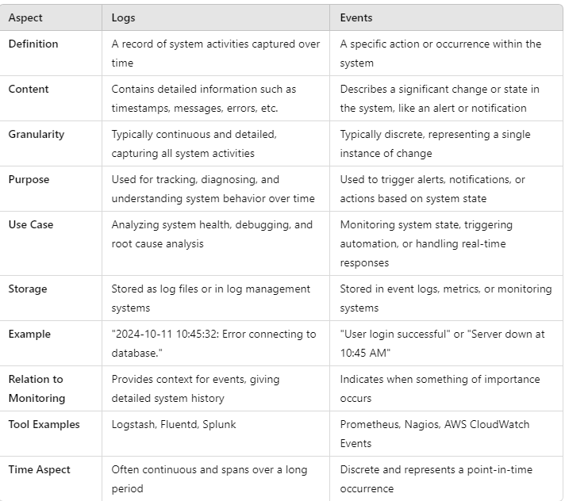
Understand logs and events

Slide 26
Understand logs and events
Logs:
A log is a detailed, time-stamped record of activity generated by systems, applications, devices, or users.
Logs capture various types of information and are used for debugging, auditing, monitoring, and analyzing the state of a system.

Slide 27
Understand logs and events
Characteristics of Logs:
Time-stamped: Logs are usually recorded with the exact time and date when the action or event occurred.
Detailed Information: Logs typically contain detailed information such as user actions, system processes, requests, errors, and system messages.
Continuous Generation: Logs are continuously generated by systems, often creating large amounts of data over time.
Text-based: Most logs are stored as plain text or in structured formats like JSON or XML.
Retained for Auditing: Logs can be stored for long periods to serve as an audit trail of system activities.

Slide 28
Understand logs and events
Types of Logs:
System Logs: Captures operating system-related activities such as boot sequences, services starting or stopping, and system errors.
Application Logs: Records events within an application, such as user requests, database queries, and application errors.
Security Logs: Includes information about user logins, permissions, access control, and failed login attempts.
Network Logs: Logs data about network traffic, firewall rules, and packet exchanges.

Slide 29
Understand logs and events
Examples of Logs:
Web server access logs capturing incoming HTTP requests.
System logs capturing user logins, reboots, or file access.
Error logs generated by applications when an error or crash occurs.

Slide 30
Understand logs and events
Events:
An event is a specific occurrence or action within a system or application, often defined by triggers or conditions.
Events represent key moments that may require attention, such as a security alert, system crash, or significant change in state.

Slide 31
Understand logs and events
Characteristics of Events:
Discrete Occurrences: An event is usually tied to a specific action or change, such as a system startup, security breach, or completed transaction.
Higher-Level Information: Events tend to summarize important activities, unlike logs which may capture more granular data.
Trigger-Based: Events are often triggered by specific conditions or thresholds, such as a system reaching a performance limit, or a user accessing restricted data.
Alerting and Monitoring: Events are often tied to monitoring systems that generate alerts, notifications, or reports for administrators.
Structured Data: Events are often captured in a more structured way, helping systems and humans process them efficiently.

Slide 32
Understand logs and events
Examples of Events:
A user successfully logs in to a system (authentication event).
A network intrusion detection system identifies a potential attack (security event).
A scheduled backup process successfully completes (system event).
An application generates a "transaction completed" event when a purchase is made.

Slide 33
Understand logs and events
Differences Between Logs and Events:
Granularity: Logs are more granular and detailed, capturing every action or change in a system, while events highlight more significant occurrences.
Purpose: Logs are used for detailed analysis, diagnostics, and audit trails, whereas events focus on triggering alerts, monitoring system health, and identifying critical issues.
Data Structure: Logs are often unstructured or semi-structured (e.g., text files), while events tend to be structured and can be more easily parsed by monitoring tools.
Storage: Logs are often stored for a long time to track past actions, while events are typically used in real-time for immediate responses or alerts.

Slide 34
Understand logs and events
Use Cases of Logs and Events:
Troubleshooting: When a system issue occurs, logs help pinpoint the exact sequence of actions that led to the issue.
For example, an error log in a web server could reveal why a particular page failed to load.
Security Monitoring: Security logs and events help detect suspicious behavior such as failed login attempts, unauthorized access, or malware activity.
Event monitoring tools can raise an alert if certain thresholds are breached (e.g., multiple failed login attempts).

Slide 35
Understand logs and events
Performance Analysis:
Logs can capture metrics such as CPU usage, memory consumption, and network traffic, helping administrators detect performance bottlenecks or inefficient processes.
Compliance Auditing: Logs serve as a record of system activity, which is often required for regulatory compliance.
Logs can show who accessed data, when, and what actions were taken.
Real-Time Monitoring and Alerting: Event management systems (like SIEM or APM tools) continuously monitor systems for events that may require immediate action, such as security breaches or system outages.

Slide 36
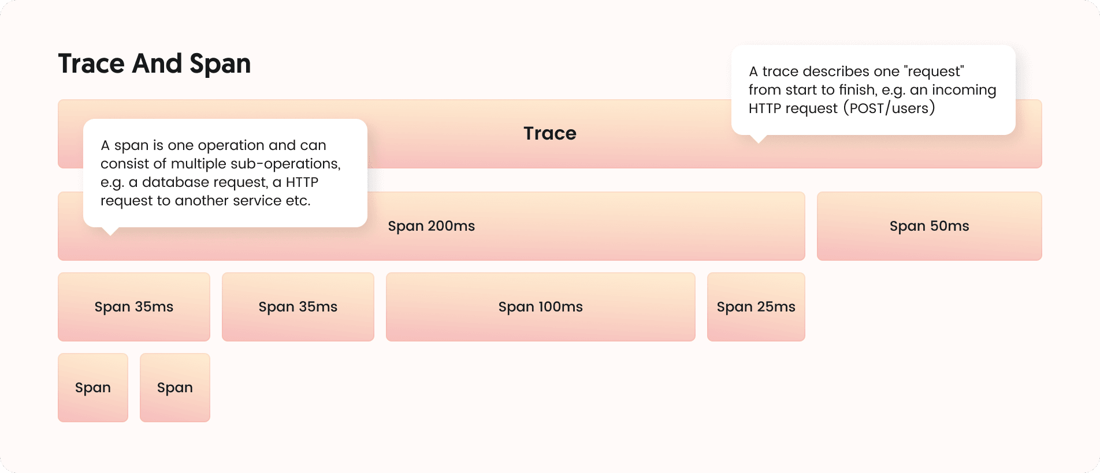
Tracing and Spans

Slide 37
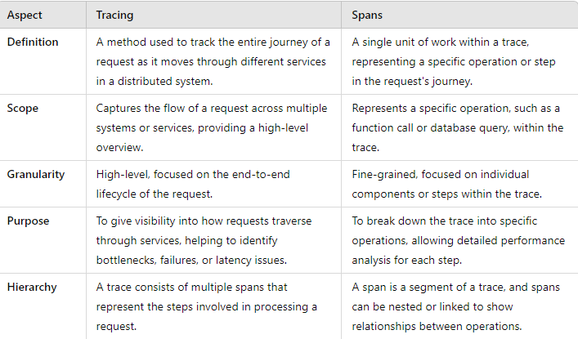
Tracing and Spans

Slide 38
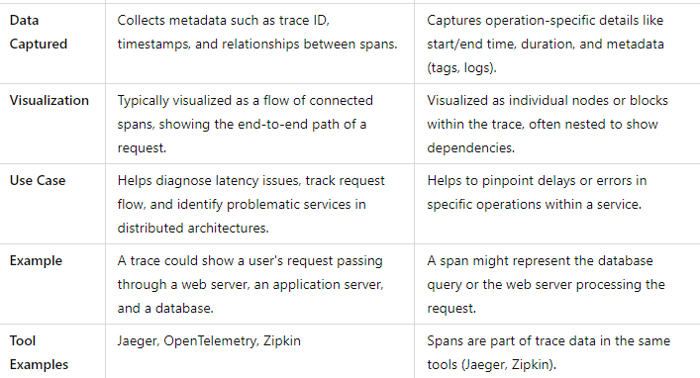
Tracing and Spans

Slide 39
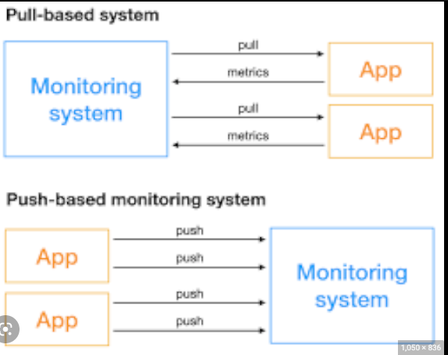
Push vs Pull

Slide 40
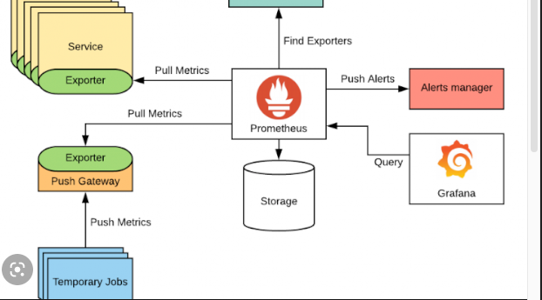
Push vs Pull

Slide 41
Push vs Pull
Pull Model (Prometheus's Native Model)
In the pull model, Prometheus regularly scrapes metrics from targets (services, servers, or applications) at specified intervals.
It pulls metrics data by sending HTTP requests to a predefined endpoint (usually /metrics).
How it works:
Prometheus server queries the /metrics endpoint of each target.
The target exposes metrics in a specific format that Prometheus understands.
Prometheus pulls data at intervals specified in its configuration.

Slide 42
Push vs Pull
Advantages:
Prometheus can control the frequency of data collection.
It can handle a dynamic list of targets and retry if one fails to respond.
Easier to monitor targets behind load balancers since Prometheus pulls from the available endpoint.
The target can remain stateless as it doesn’t need to track which systems want its metrics.

Slide 43
Push vs Pull
Disadvantages:
May not work well for short-lived jobs, as these may disappear before Prometheus scrapes their metrics.
Not ideal for environments where network access from Prometheus to the target is restricted.

Slide 44
Push vs Pull
Push Model (Not Native to Prometheus but Achievable)
The push model involves the target sending (pushing) its metrics to a central location.
Prometheus does not natively support a push mechanism, but the Pushgateway component fills this gap.
The Pushgateway acts as an intermediary that receives metrics from applications (especially short-lived jobs) and exposes them to Prometheus.

Slide 45
Push vs Pull
How it works:
Targets push their metrics to a Push gateway.
The Push gateway exposes a /metrics endpoint for Prometheus to scrape the pushed data.
The Push gateway stores the metrics until Prometheus pulls them.

Slide 46
Push vs Pull
Advantages:
Suitable for short-lived jobs (e.g., batch jobs or CI jobs) that might finish execution before Prometheus can scrape them.
Can work in environments where the network setup restricts Prometheus from pulling metrics directly from targets (e.g., firewalls, private networks).
Useful when the target cannot keep an HTTP server running to expose metrics continuously.

Slide 47
Push vs Pull
Disadvantages:
Introduces an extra component (Push gateway), which adds complexity.
The state of the Push gateway must be managed, as it retains data until explicitly deleted.
Push gateway is not designed for continuous metrics (e.g., long-lived services); it's primarily intended for short-lived jobs.

Slide 48
Service Discovery
Service discovery is a key concept in microservices and distributed systems.
It refers to the process of automatically detecting and connecting microservices in a network.
In these environments, services communicate with each other, and their locations (IP addresses, ports) may change dynamically due to scaling, failures, or deployments.
Service discovery helps maintain seamless communication between services despite these changes.

Slide 49
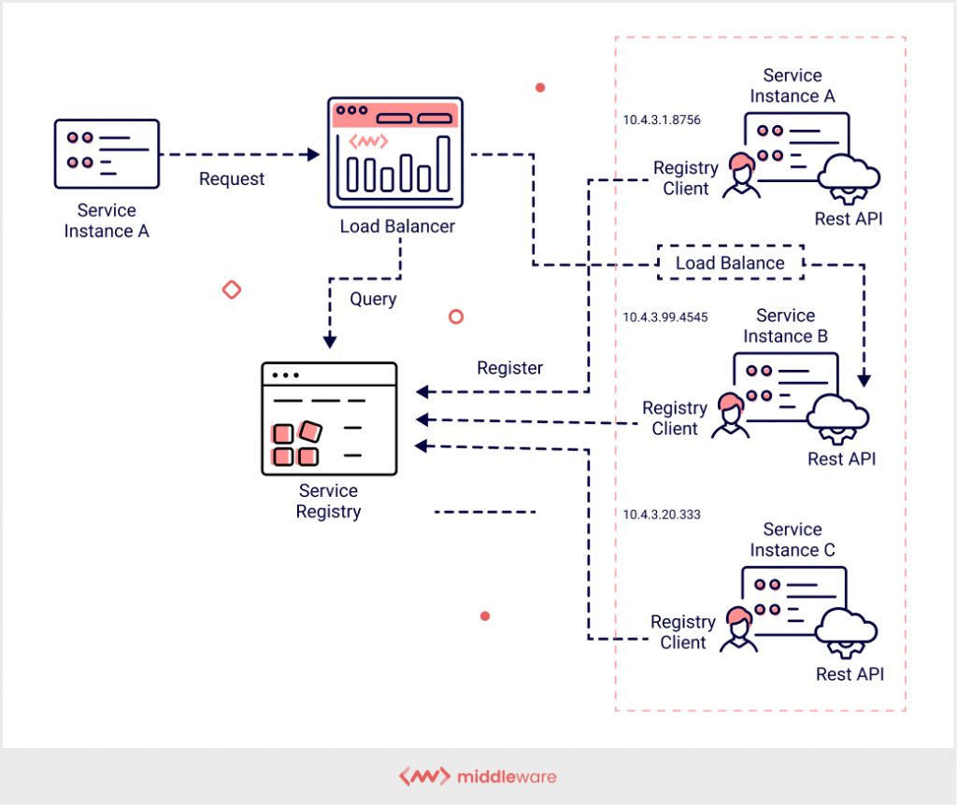
Service Discovery

Slide 50
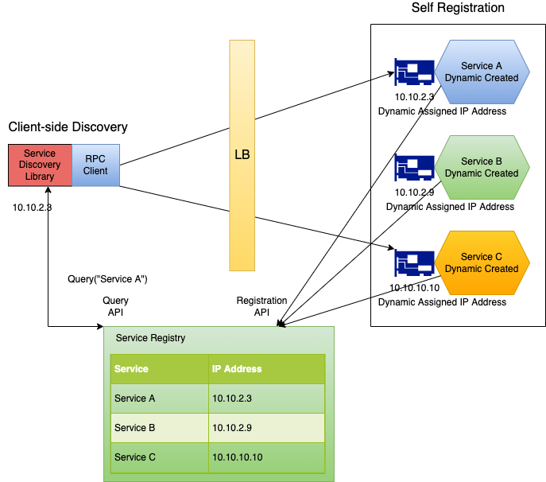
Service Discovery

Slide 51
Service Discovery
1. Client-side discovery:
In client-side discovery, the client (the service that wants to make a request) is responsible for determining the location of service instances.
A service registry contains the addresses of all available services.
The client queries the registry to find a valid service instance and then sends a request directly to the selected instance.

Slide 52
Service Discovery
Components:
Service Registry: A centralized database that tracks all instances of services.
Client: The service that queries the service registry and selects a service instance.
Examples:
Netflix Eureka (client-side service discovery)
Consul (can be used for client-side)

Slide 53
Service Discovery
Server-side discovery:
In server-side discovery, the client sends a request to a load balancer, which in turn queries the service registry and forwards the request to an appropriate service instance.
The client is unaware of where the actual service instance is located; it simply sends the request to the load balancer.

Slide 54
Service Discovery
Components:
Service Registry: Stores the locations of services.
Load Balancer/Service Proxy: Acts as an intermediary between the client and service instances.
Examples:
AWS Elastic Load Balancing (ELB)
Kubernetes (through the use of DNS or environment variables)

Slide 55
Service Discovery
Common Technologies for Service Discovery:
Eureka: A service discovery tool developed by Netflix for client-side discovery.
Consul: A service mesh and service discovery tool from HashiCorp that supports both client-side and server-side discovery.
Kubernetes: Uses internal DNS or environment variables for service discovery within a cluster.
Zookeeper: Often used with Apache frameworks for service discovery.

Slide 56
Service Discovery
How it Works:
Service Registration: When a new service instance starts, it registers itself with the service registry, providing details like IP address, port, and metadata.
Service Deregistration: When a service instance stops, it deregisters itself from the registry to avoid sending traffic to unavailable instances.
Health Checks: The registry may periodically perform health checks to ensure that the registered services are available and healthy.

Slide 57
Service Discovery
Benefits of Service Discovery:
Scalability: Helps services find and communicate with each other dynamically, supporting high levels of scaling.
Resilience: Allows systems to adapt to changes in the environment, such as instances going down or new ones being added.
Flexibility: Can support different deployment environments (cloud, containers, on-premises).

Slide 58
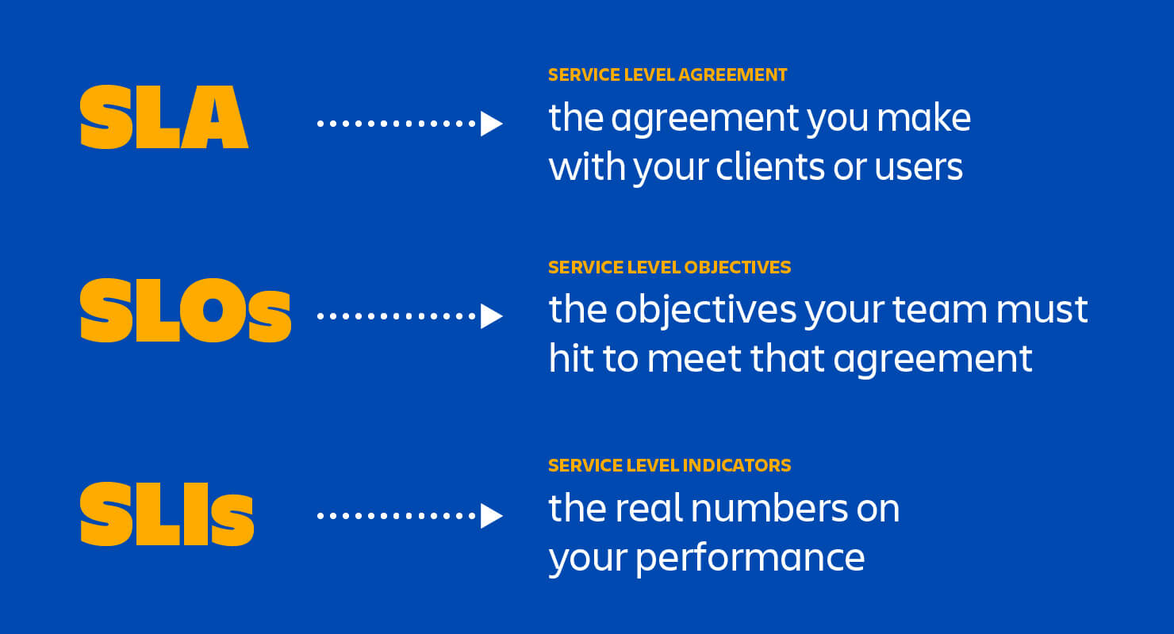
SLA vs SLO vs SLI

Slide 59
Basics of SLOs, SLAs, and SLIs
SLA (Service Level Agreement):
An SLA is a formal agreement between a service provider and a customer.
It defines the specific measurable service performance standards that the provider is obligated to meet.
SLAs are typically legally binding and include consequences (such as penalties or service credits) if the service provider fails to meet the agreed-upon standards.

Slide 60
Basics of SLOs, SLAs, and SLIs
Key Points:
Purpose: Sets expectations for service performance and outlines responsibilities between the provider and customer.
Enforceability: Often legally binding with penalties for non-compliance.
Example: "The service provider guarantees 99.9% uptime over a month. If this is not met, the customer will receive a 5% refund of the monthly service fee."

Slide 61
Basics of SLOs, SLAs, and SLIs
SLO (Service Level Objective):
An SLO is a specific, measurable goal that defines the acceptable performance level of a service.
SLOs are part of the SLA but are less formal than the SLA itself.
They act as internal targets for the service provider, helping to ensure that the SLAs are met.
The SLO is used to define performance objectives like availability, latency, or response times.

Slide 62
Basics of SLOs, SLAs, and SLIs
Key Points:
Purpose: Sets measurable objectives that help the service provider track and maintain service levels.
Measurable: Clearly defined metrics such as uptime percentage, error rates, or latency thresholds.
Example: "The system should have an uptime of 99.9% each month."

Slide 63
Basics of SLOs, SLAs, and SLIs
SLI (Service Level Indicator):
An SLI is the actual measurement or metric that indicates how well a service is performing against the SLOs.
SLIs are quantitative measurements, typically expressed as percentages or time units, that track specific characteristics of a service (such as availability, latency, throughput, or error rate).
SLIs provide the data that allows a provider to understand whether they are meeting their SLOs and SLAs.

Slide 64
Basics of SLOs, SLAs, and SLIs
Key Points:
Purpose: Provides real-time metrics or measurements of service performance.
Monitoring: Often collected through monitoring tools and compared against SLOs.
Example: "The service achieved 99.95% uptime last month" (where uptime is the SLI).

Slide 65
Prometheus fundamentals

Slide 66
Prometheus
Prometheus is an open-source technology designed to provide monitoring and alerting functionality for cloud-native environments, including Kubernetes.
It can collect and store metrics as time-series data, recording information with a timestamp.
It can also collect and record labels, which are optional key-value pairs.

Slide 67
Prometheus Features
Multidimensional data model – Using time-series data, which is identified by metric name and key-value pairs.
PromQL – A flexible querying language that can leverage the multi-dimensional data model.
No reliance on distributed storage – All single server nodes remain autonomous.
Pull model – Prometheus can collect time-series data by actively “pulling” data over HTTP.
Pushing time-series data – Available through the use of an intermediary gateway.
Monitoring target discovery – Available through static configuration or service discovery.
Visualization – Prometheus offers multiple types of graphs and dashboards.

Slide 68
Micrometer Prometheus
Micrometer provides a simple facade over the instrumentation clients for the most popular monitoring systems.
It allows us to instrument JVM-based application code without vendor lock-in.
Micrometer is an open-source project and provides a metric facade that exposes metric data in a vendor-neutral format that a monitoring system can understand.

Slide 69
Monitoring Systems
These monitoring systems are supported:
AppOptics
Azure Monitor
Netflix Atlas
CloudWatch
Datadog
Dynatrace
Elastic
Ganglia
Graphite
Humio
Influx/Telegraf
JMX
KairosDB
New Relic
Prometheus
SignalFx
Google Stackdriver
StatsD
Wavefront

Slide 70
How Does Prometheus Monitoring Work?
To get metrics, Prometheus requires an exposed HTTP endpoint.
Once an endpoint is available, Prometheus can start scraping numerical data, capture it as a time series, and store it in a local database suited to time-series data.
Prometheus can also be integrated with remote storage repositories.

Slide 71
How Does Prometheus Monitoring Work?
Users can leverage queries to create temporary times series from the source.
These series are defined by metric names and labels.
Queries are written in PromQL, a unique language that allows users to choose and aggregate time-series data in real time.
PromQL can also help us establish alert conditions, resulting in notifications to external systems like email, PagerDuty, or Slack.

Slide 72
How Does Prometheus Monitoring Work?
Prometheus can display collected data in tabular or graph form, shown in its web-based user interface.
We can also use APIs to integrate with third-party visualization solutions like Grafana.

Slide 73
What Can You Monitor with Prometheus?
Prometheus is a versatile monitoring tool, which you can use to monitor a variety of infrastructure and application metrics.
Use Cases
Service Metrics
Host Metrics
Website Uptime/Up Status
Cronjobs

Slide 74
Service Metrics
Prometheus is typically used to collect numeric metrics from services that run 24/7.
It allows metric data to be accessed via HTTP endpoints.
This can be done manually or with various client libraries.
Prometheus exposes data using a simple format, with a new line for each metric, separated with line feed characters.
The file is published on an HTTP server that Prometheus can query and scrape metrics from based on the specified path, port, and hostname.
Prometheus can also be used for distributed services, which are run on multiple hosts.
Each instance publishes its own metrics and has a name that Prometheus can distinguish.

Slide 75
Host Metrics
We can monitor the operating system to identify when a server’s hard disk is full or if a server operates constantly at 100% CPU.
We can install a special exporter on the host to collect the operating system information and publish it to an HTTP-reachable location.

Slide 76
Website Uptime/Up Status
Prometheus doesn’t usually monitor website status, but we can use a black box exporter to enable this.
We specify the target URL to query an endpoint.
It performs an uptime check to receive information such as the website’s response time.
We define the hosts to be queried in the prometheus.yml configuration file, using relabel_configs to ensure Prometheus uses the black box exporter.

Slide 77
Cronjobs
To check if a cronjob is running at the specified intervals, we can use the Push Gateway to display metrics to Prometheus through an HTTP endpoint.
We can push the timestamp of the last successful job (i.e. a backup job) to the Gateway and compare it with the current time in Prometheus.
If the time exceeds the specified threshold, the monitor times out and triggers an alert.

Slide 78
Prometheus Metric Types
The client libraries of Prometheus offer three core types of metrics.
However, the Prometheus server does not currently save these metrics as different data types.
Instead, it flattens all information into an untyped time series.

Slide 79
Prometheus Metric Types
Counter
This is a cumulative metric. It represents a single monotonically-increasing counter, and its value can either increase or be reset to zero on restart.
Gauge
This metric represents one numerical value, which can arbitrarily go down and up.
A gauge is often used to measure values like current memory usage or temperatures.
Histogram
A histogram samples observations, such as request durations or response sizes.
It then counts the observations in a configurable bucket.
A histogram can also provide a total sum of all the observed values.

Slide 80
Prometheus Architecture
Prometheus follows a pull-based model where it scrapes metrics from monitored targets at specified intervals.
It uses a multi-dimensional data model for storing time-series data and provides a flexible query language called PromQL to retrieve and analyze this data.
Prometheus is a standalone service that doesn’t require external storage.

Slide 81
Prometheus Architecture
Key Components of Prometheus Architecture:
Prometheus Server:
The Prometheus server is at the core of the system architecture. It is responsible for:
Data Collection: Scraping metrics from target services at defined intervals.
Data Storage: Storing scraped time-series data in a local time-series database (TSDB).
Querying: Processing queries written in PromQL to retrieve and analyze the collected data.

Slide 82
Prometheus Architecture
Targets (Instrumented Services):
Targets are the systems and applications being monitored by Prometheus.
These targets expose metrics via an HTTP endpoint (typically /metrics), which Prometheus scrapes.
Prometheus interacts with these services by pulling metrics from them at regular intervals.
Targets can be instrumented applications, exporters, or third-party systems like databases or cloud services.

Slide 83
Prometheus Architecture
Exporters:
Exporters are specialized services that expose metrics from third-party systems or non-instrumented services in a Prometheus-compatible format.
Common exporters:
Node Exporter: Exposes system-level metrics (CPU, memory, disk, etc.).
Blackbox Exporter: Probes endpoints (HTTP, DNS, ICMP) to check for uptime and reachability.
Database Exporters (e.g., MySQL, PostgreSQL): Export database-specific metrics.

Slide 84
Prometheus Architecture
Service Discovery:
Prometheus supports dynamic service discovery, which allows it to automatically find and scrape targets in dynamic environments (e.g., cloud, Kubernetes).
It supports a variety of service discovery mechanisms:
Kubernetes
Consul
EC2 instances
DNS-based discovery
Service discovery helps in automatically adapting to infrastructure changes, such as when services scale up or down.

Slide 85
Prometheus Architecture
Time-Series Database (TSDB):
Prometheus stores all metrics as time-series data, identified by a unique metric name and label set.
The time-series data is stored locally on disk and compressed to optimize space.
Data is kept for a configurable retention period, after which it is deleted.

Slide 86
Prometheus Architecture
Alert manager:
Alert manager handles alerts generated by Prometheus when a rule condition is met (e.g., high CPU usage).
Prometheus evaluates alerting rules against the data and pushes alerts to the Alertmanager.
Alert manager’s Role:
Alert Deduplication: Prevents repeated alerts for the same issue.
Grouping: Groups related alerts to reduce noise.
Routing: Sends alerts to the appropriate receiver (email, Slack, PagerDuty, etc.).
Silencing: Temporarily suppresses alerts during planned maintenance.

Slide 87
Prometheus Architecture
Prometheus Client Libraries:
Prometheus provides client libraries for different programming languages (Go, Python, Java, Ruby, etc.) to enable custom metrics instrumentation in applications.
Developers can use these libraries to instrument their code and expose custom application-specific metrics.

Slide 88
Prometheus Architecture
PromQL (Prometheus Query Language):
Prometheus comes with its own powerful query language, PromQL, which allows users to select and aggregate time-series data.
PromQL supports complex operations like rate calculations, aggregations, and joins across metrics.

Slide 89
Prometheus Architecture
Pushgateway (Optional):
Prometheus uses a pull model, but sometimes systems may not be suited to be scraped (e.g., batch jobs or short-lived processes).
The Pushgateway allows these systems to push metrics to Prometheus. It acts as an intermediary for these metrics, storing them until Prometheus pulls them.

Slide 90
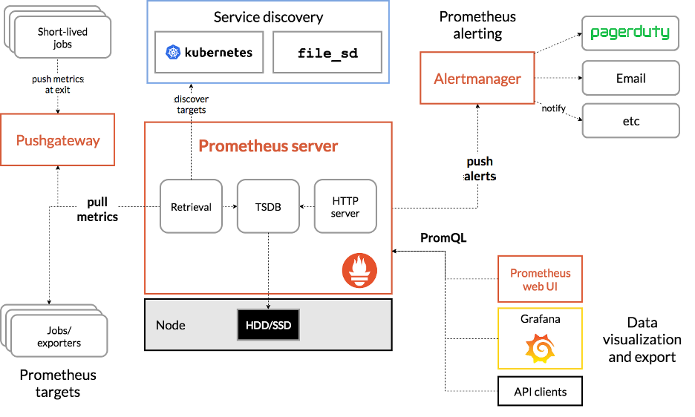
Prometheus Component Architecture

Slide 91
Prometheus Server
The Prometheus server handles the scraping and storing of metrics.
The server manages scheduling of monitoring jobs – querying data sources (called “instances”) at a predefined polling frequency.
Monitoring jobs are configured via one or more “scrape config” directives, managed via a YAML configuration file.
It can be live-reloaded using a SIGHUP or the Management API.

Slide 92
Prometheus Server
Prometheus relies heavily on various service discovery (SD) mechanisms to identify targets to scrape.
These service discovery integrations range from generic interfaces like a file-based service discovery that custom SD implementations can leverage by managing a JSON or YAML file containing a list of targets.

Slide 93
Prometheus Server
Prometheus also provides number of platform-specific SD implementations, including: Kubernetes, AWS EC2, Azure, GCE, Docker Swarm, OpenStack, and more.
These generally integrate with the corresponding APIs to query the platform for targets running applications and exporters that can be scraped by Prometheus.

Slide 94
Prometheus Data Flow
Scraping:
Prometheus scrapes metrics from the targets (applications, services, exporters) at a configured interval via HTTP. Each target exposes an endpoint that Prometheus polls for metrics.
Storing:
Scraped metrics are stored in Prometheus’s internal time-series database.
Each metric is stored as a time-series, identified by a combination of a metric name and key-value labels.
Example metric format:

Slide 95
Prometheus Data Flow
Querying:
Users or external systems (like dashboards) can query the stored time-series data using PromQL.
Queries can be used to retrieve data for monitoring, debugging, or performance analysis.
Alerting:
Prometheus evaluates alerting rules against the stored data at regular intervals.
When an alert condition is met (e.g., CPU usage > 90% for 5 minutes), an alert is triggered and sent to the Alert manager.
Alert manager processes and routes the alerts to defined destinations like Slack, PagerDuty, or email.

Slide 96
Key Features and Benefits of Prometheus Architecture
Pull-based Model:
Prometheus’s pull model allows it to periodically scrape metrics from targets, making it more efficient and flexible in discovering new services or handling dynamic infrastructure.
Time-Series Data Storage:
Prometheus uses a highly optimized time-series database, enabling efficient storage and querying of millions of metrics.
Multi-dimensional Data Model:
Prometheus uses labels to add dimensions to metrics, making it easier to filter and group metrics based on these labels.

Slide 97
Key Features and Benefits of Prometheus Architecture
PromQL:
The powerful query language enables deep insights into system behavior through metrics aggregation, filtering, and real-time analysis.
Service Discovery:
Dynamic environments like Kubernetes benefit from Prometheus’s ability to auto-discover new targets, making it a natural choice for cloud-native monitoring.
Self-Contained:
Prometheus operates independently, without external dependencies, and can be scaled by federating multiple Prometheus servers.

Slide 98
Integration Systems
Grafana:
Prometheus is often integrated with Grafana for visualizing metrics using dashboards.
Thanos/Cortex:
For long-term storage and scalability, Prometheus can be extended with projects like Thanos or Cortex to store metrics across multiple Prometheus instances and enable long-term storage and queries.

Slide 99
Questions

